Slide 1
Mitosis Onion root tip & Whitefish blastula
If you were unable to get
clear images with your microscope,
use these images to complete your lab.

Slide 2
Onion Root Tip - 200 x

Slide 3
Onion Root Tip - 400x

Slide 4
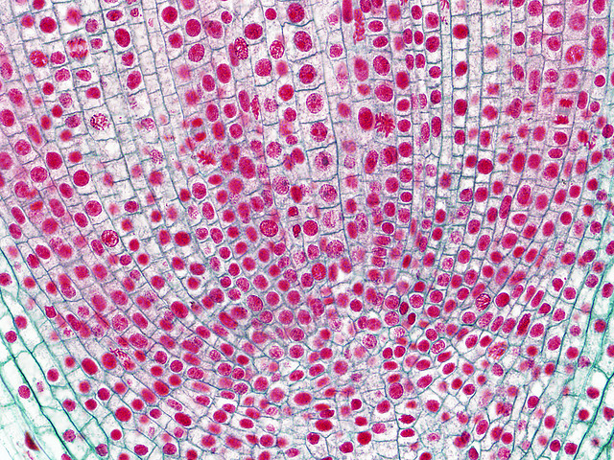
Whitefish blastula – 200x

Slide 5
Whitefish blastula – 400x

