Slide 1
Specialized Plant and Animal Cells
SNC2D
Ms. Papaiconomou

Slide 2
Regeneration
Process whereby a body part is replaced or re-grown through the process of mitosis
The liver is the only human organ that can naturally regenerate
Research continues in the field of regeneration of organs
Fingertip
Bladder
Blood vessels

Slide 4
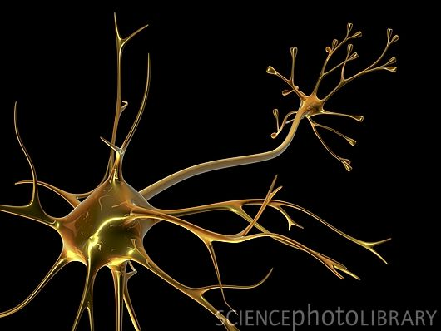
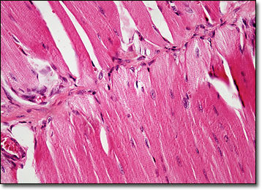
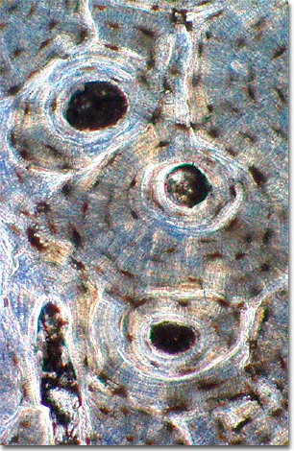
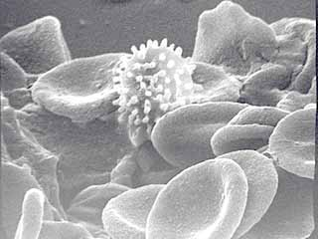
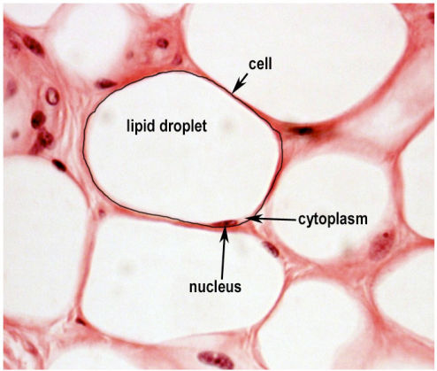
Cell Specialization
Specialized cells
A cell that can perform a specific function
Have physical and chemical differences that allow them to perform one job very well
Can look very different from each other based on the function of the cell
Neuron
Blood cells
Fat cell
Muscle cell
Bone cell

Slide 5
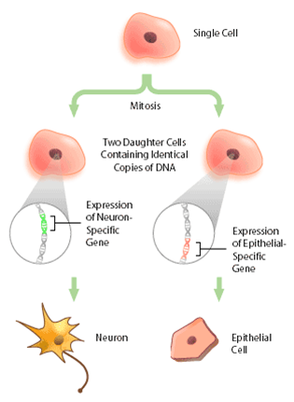
How do Cells Specialize?
Cells specialize as a result of producing different proteins.
Although all cells have the same DNA and the same genes, not all cells use all their genes.
Certain genes are activated in some cells and deactivated in others.
Main factors affecting differentiation
Contents of cell’s cytoplasm
Environmental conditions
Influence of neighbouring cells

Slide 6
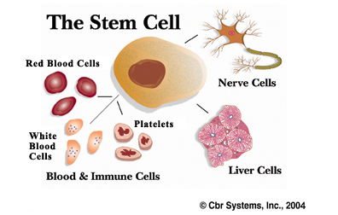
Where did all these specialized cells come from?
Unspecialized cells that can form specialized cells
Can remain unspecialized for a long time
Plants: Meristematic Cell or Meristem
Found in growing tips of roots & stem, and cambium of stem
Animals: Stem Cell
Embryonic or adult stem cells

Slide 7
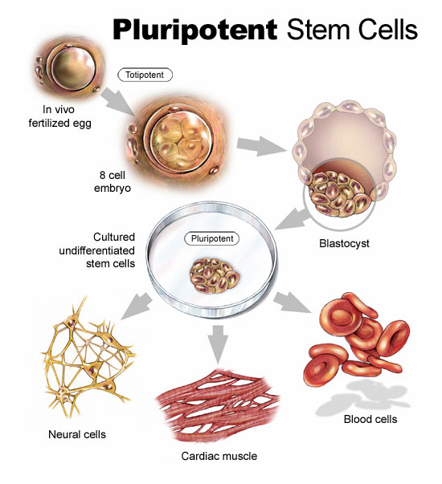
Where Do Stem Cells Come from?
Embryonic Stem Cells
From an embryos that is less than a week old
Can differentiate into all other cell types
Adult Stem Cells
Found in adults
Limited ability to create cell types

Slide 8
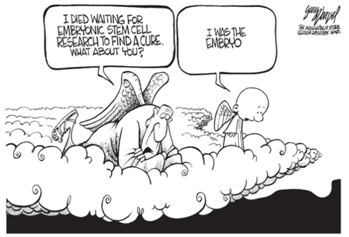
Stem Cell Research
Used in the treatment of
Cancer
Parkinson’s disease
Alzheimer’s disease
Stroke
Heart disease
Diabetes
Rheumatoid arthritis.
There is much public debate about the use of embryonic stem cells. It is possible to harvest a few embryonic stem cells from the umbilical cord or placenta, but to collect larger amounts of embryonic stem cells; it is necessary to destroy the embryo.

Slide 9
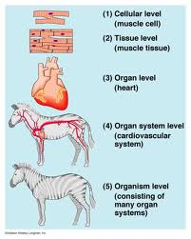
So How Do Cells Come Together and Make An Organism?
Least complex
Cells
Tissues
Collection of similar cells that perform a particular but limited function
Organs
Structure composed of different tissues working together to perform a complex body function
Organ Systems
System of one or more organs and structures that work together to perform a major vital body function
Organism
Most complex

Slide 10
Animal Tissues
Tissue Type | Description | Function | Example
Connective Tissue | Various types of cells and fibres held together by a liquid, solid or gel (matrix) | - Support - Insulation | Bone Blood Fat Tendons
Epithelial Tissue | Thin sheets of tightly packed cells covering surfaces and lining internal organs | - Protection from dehydration - low-friction surfaces | Skin Lining of the respiratory and digestive system
Muscle Tissue | Bundles of long cells called muscle fibres that contain specialized proteins capable of shortening or contracting | Movement | -Skeletal muscle Smooth muscle Cardiac muscle
Nervous Tissue | Long, thin cells with fine branches at the ends capable of conducting electrical impulses | -Sensory -Communication within the body -Coordination of body functions | -Brain -Nerves in sensory organs

Slide 11
Plant Tissues
Tissue Type | Description | Major Functions
Epidermal tissue | Clear, very thin | Forms the protective outer covering Allows the exchange of materials and gases into and out of the plant
Vascular tissue | Transport of materials | Xylem: moves water and minerals from the roots to the leaves Phloem: transports sugars from the leaves to other parts of the plant
Ground tissue | -Makes up most of the plant | Stem: provides strength and support Root: stores food and water Leaf: where photosynthesis occurs
Meristematic Tissue | Responsible for growth of plant | Unspecialized tissue capable of dividing by mitosis Found in several locations in the plant Responsible for growing new parts of the plant

Slide 12
Homework
Read section 1.3 on pp.38-46
Answer the following questions:
p.47 Q. 1-5, 8, 10-16
We have completed Chapter 1!
Your Chapter 1 Test will be on: October 24 (Day 1/3) or October 25 (2/4)
Chapter Review Questions pp. 50-51 Q.1-27
Topics: Types of Cells & Organelles, Microscopy, Cell Cycle & Cell Division (iPMATc), Cell Death & Cancer, Specialized Cells & Tissues

